Slide 1

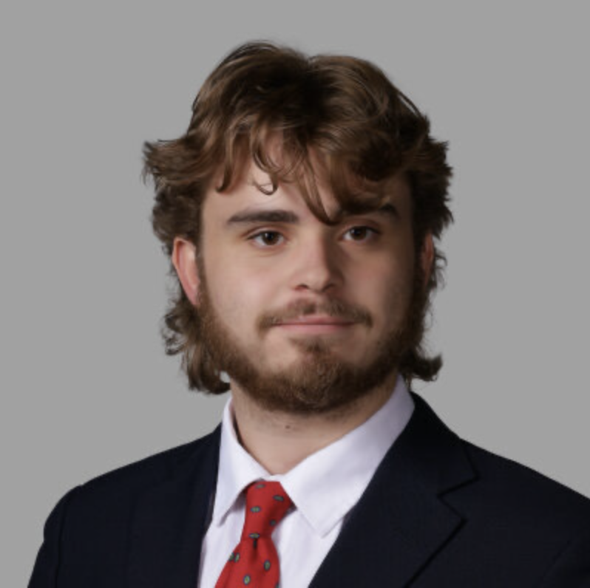
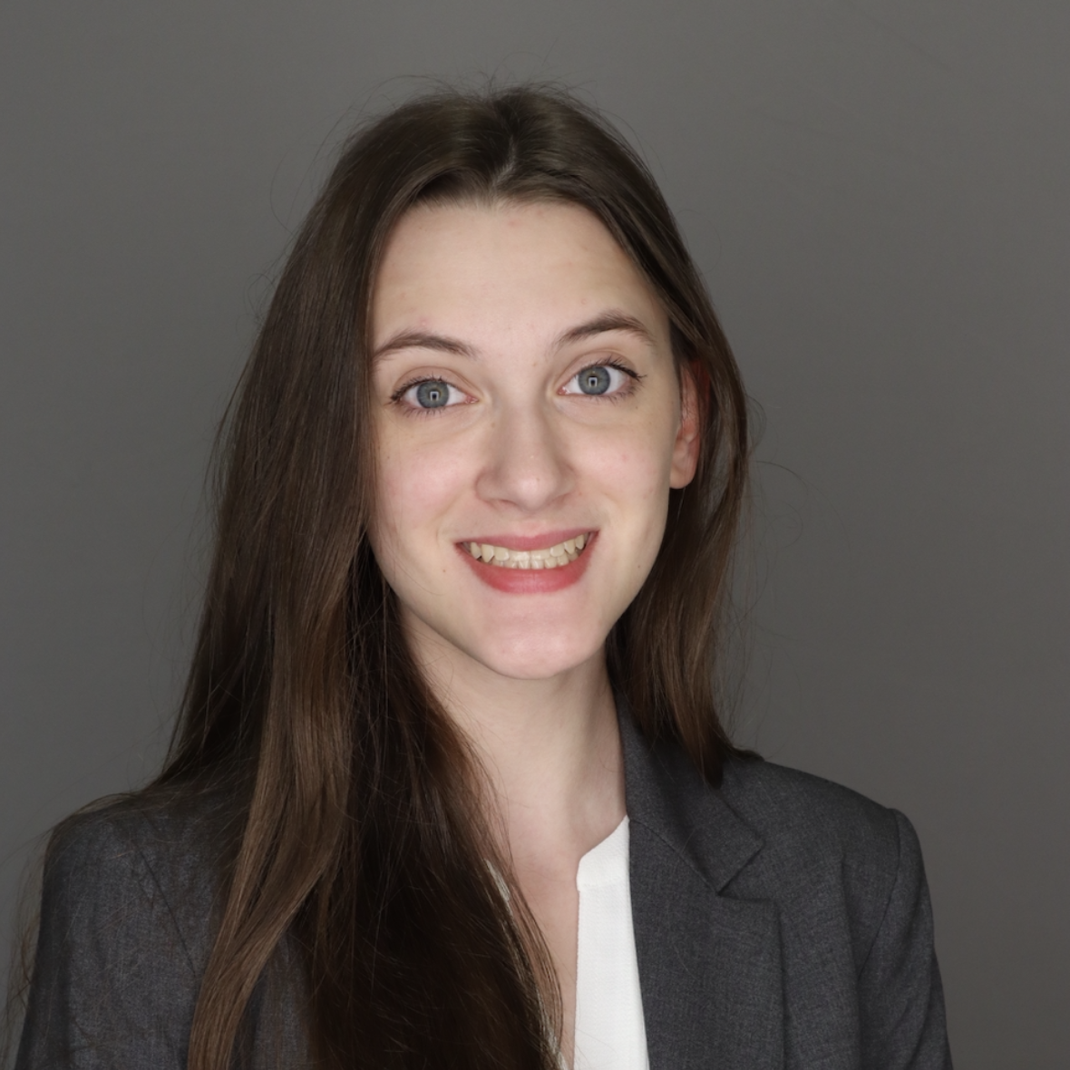
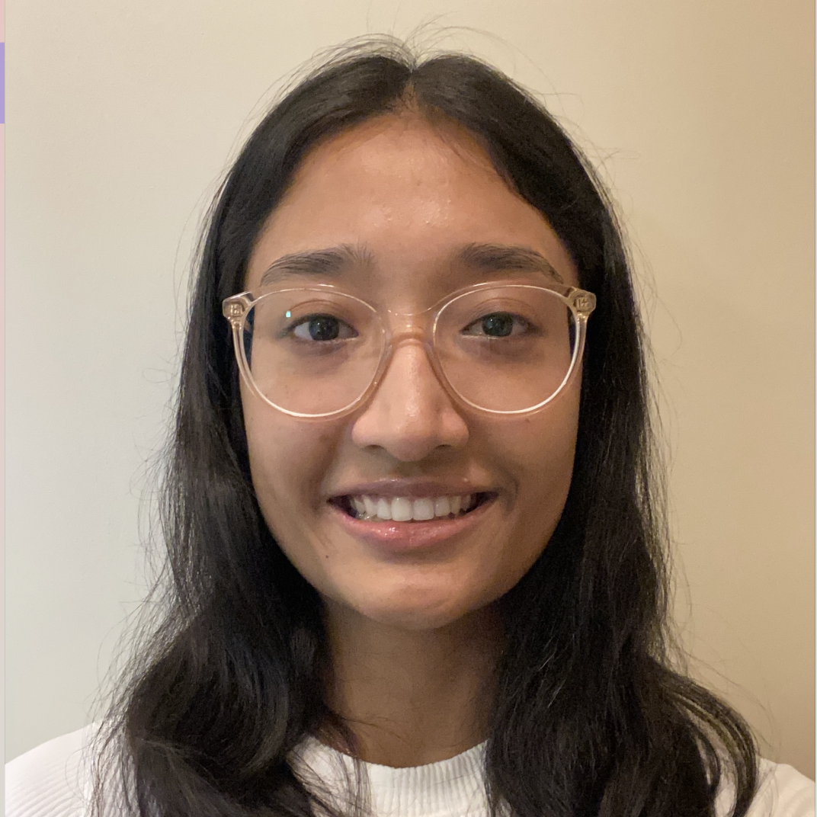

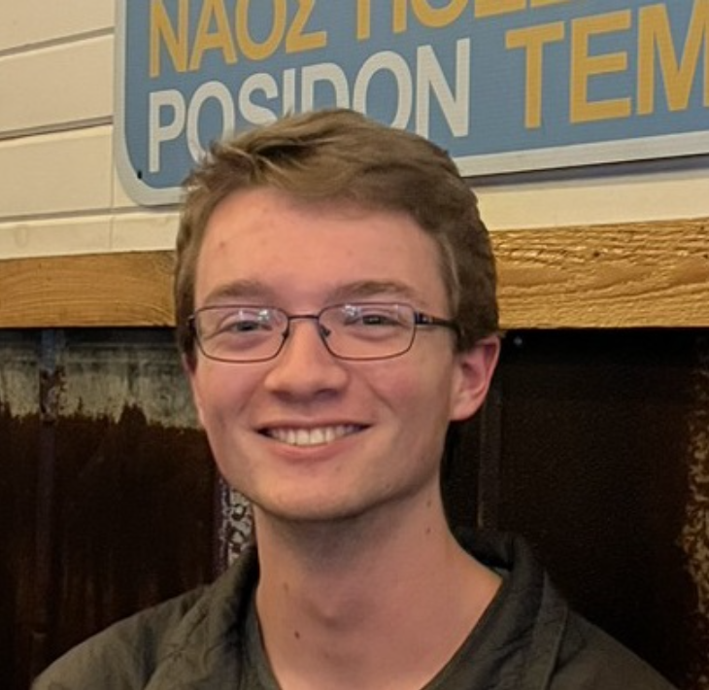
Mentor management system
By: Andrew Hahn, Hannah Hazelwood, Manjila Singh, Gregory Nothnagel
Source code: https://github.com/manjilasingh/mentor-management-system
Cloud Hosted Website: https://34.170.92.44:3000 Project website: https://hhaze2.github.io/

Slide 2


Project OVERVIEW
CS department needs a mentorship program
20-25 mentors, 1100 students
Facilitate interaction through web app
Enhance networking, confidence, and growth for students
Enhance leadership, personal fulfillment, and networking for mentors

Slide 3
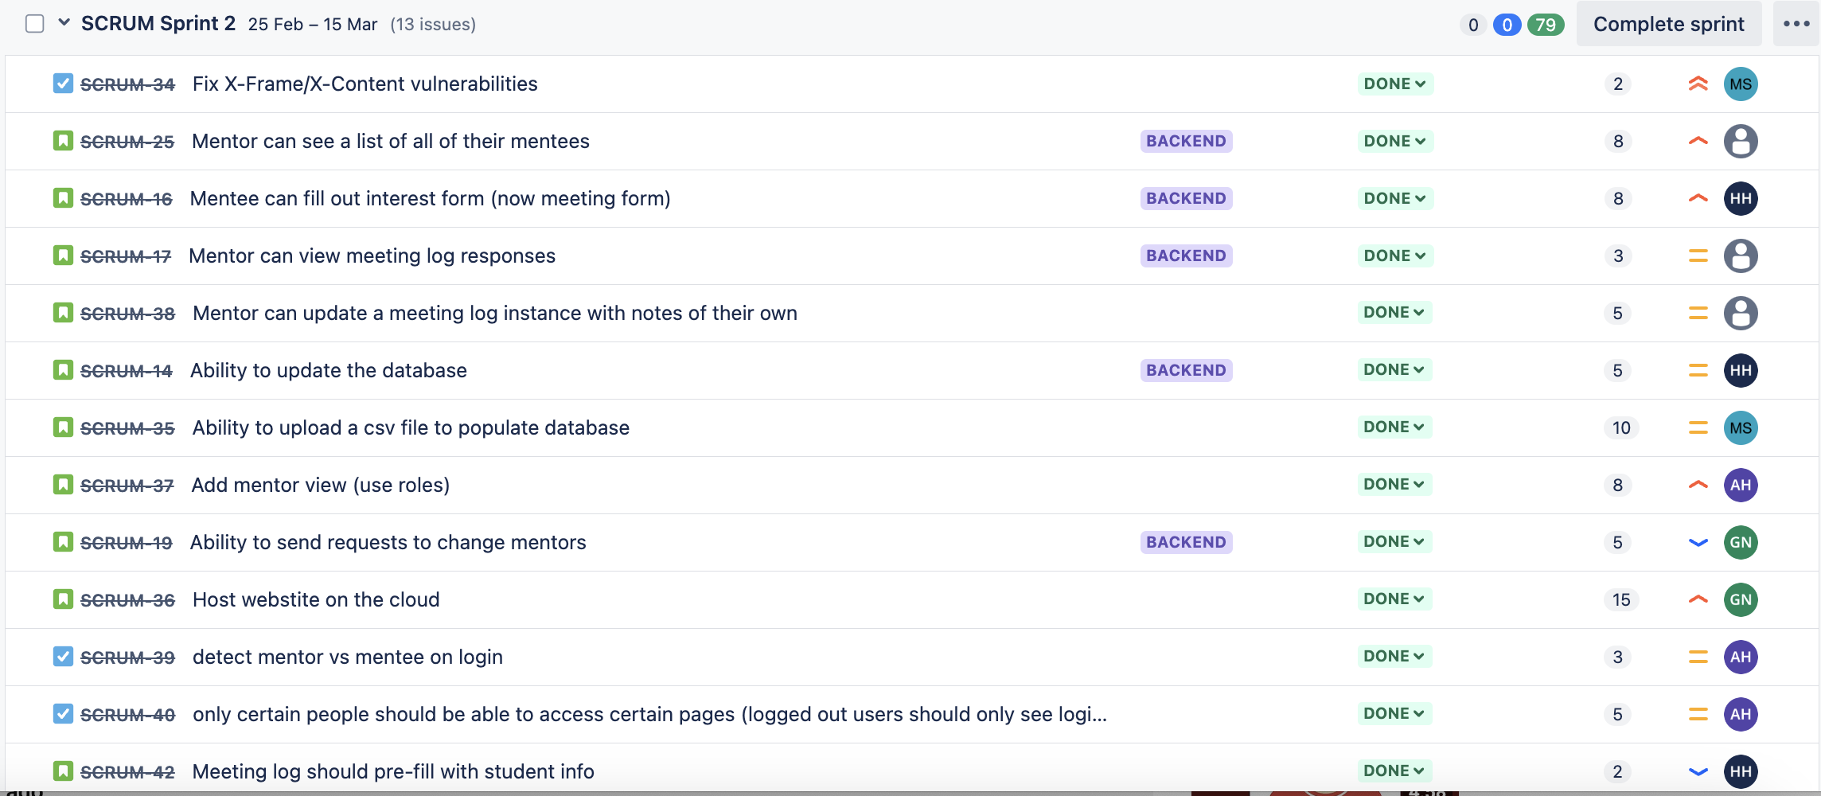
Sprint backlog

Slide 4
Team members contribution
Hannah – Implemented the Meeting Log
Gregory – Google cloud hosting
Manjila – Implemented the CSV import functionality
Andy - Added separate view for Mentors who log into our website

Slide 5
Comparison to sprint 1
Aspect | Sprint 1 | Sprint 2
Focus | Initial setup and basic functionality | Cloud deployment and user role-based views
Authentication | Microsoft OAuth Login for any students with crimson email | Restrict access to only users in the database
User Views | Same view for all users | Detect mentor or student role upon login and display view accordingly
Admin Functionality | Manually add users one by one | Batch import users into database using excel file
Deployment | Local development with Docker (http) | Cloud hosting (https)

Slide 6
SPRINT REFLECTION
What went well:
Google cloud hosting
CSV import functionality
Database structure changes
What didn’t?
Cloud hosting is a long process
How to handle student cohorts
Areas of improvement?
Communication
Documentation

Slide 7
Sponsor Feedback
"Sleek" webpage layout
Should be fully complete by the end of the semester
Change multiple students' mentors at once (bulk changes)
Make students confirm with mentor before asking Dr. Anderson for a mentor change
Fully document the hosting process for easy deployment

Slide 8
Demo time
Website: https://34.170.92.44:3000/ (frontend)
https://34.170.92.44:8000/admin/ (admin dashboard)
Example CSV: https://bama365-my.sharepoint.com/:x:/g/personal/hrhazelwood_crimson_ua_edu/EUQcfAEwgG1FqjE__TCUqSwBUOxed6ClR4rgWGRZ_p32vA?e=st96Qh
Notes:
Start with me not in system. Try to log in to show that students not in system cannot log in
Add myself to the database. Do this using the add csv button. Will not replicate students, checks cwid
Then log into the student page. Show the profile page with student info, and show that you can edit things
Then show the meeting log. Show that it prefills the student information. Then add a meeting log. Change something (major maybe) to show that the student profile will update with this form
Log out of student view. Go into admin and make myself a mentor
Log in again. Show the new mentor view. Start with the all students page, click on a student
Then go to the my students page show that you can click and see both student info and meeting logs. Show that you can add mentor notes to the meeting log

Slide 9
Demo Video (in case of issue with live demo):
https://alabama.box.com/s/fjiyna60981nxuq4dxwp7r10z6pjh4eo

